Slide 1
M Tech(Data Science & Engineering) Introduction to Statistical Methods
Team ISM

Slide 2
Session No 2
Probability basics , Conditional Probability and Bayes Theorem
(Session 2: 14th/15th May 2022
)

Slide 3
Agenda
Experiments, Counting Rules, and Assigning Probabilities
Events and Their Probability
Some Basic Relationships of Probability
Conditional Probability
Bayes’ Theorem

Slide 4
Random Experiment
Term "random experiment" is used to describe any action whose outcome is not known in advance. Here are some examples of experiments dealing with statistical data:
Tossing a coin
Counting how many times a certain word or a combination of words appears in the text of the “King Lear” or in a text of Confucius
counting occurrences of a certain combination of amino acids in a protein database.
pulling a card from the deck

Slide 5
Sample spaces, sample sets and events
The sample space of a random experiment is a set S that includes all possible outcomes of the experiment.
For example, if the experiment is to throw a die and record the outcome, the sample space is S = { 1,2,3,4,5,6}

Slide 6
Discrete sample spaces.
Continuous sample spaces

Slide 7
Discrete Random Variables
A discrete random variable is one which may take on only a countable number of distinct values such as 0,
1, 2, 3, 4,....
• Discrete random variables are usually (but not necessarily) counts.
Examples:
number of children in a family
the Friday night attendance at a cinema
the number of patients a doctor sees in one day
the number of defective light bulbs in a box of ten
the number of “heads” flipped in 3 trials

Slide 8
Continuous Random Variable
A continuous random variable is one which takes an infinite number of possible values.
Examples:
height
weight
the amount of sugar in an orange
the time required to run a mile.

Slide 9
Event
An event is a set of outcomes of the experiment. This includes the null (empty) set of outcomes and the set of all outcomes. Each time the experiment is run, a given event A either occurs, if the outcome of the experiment is an element of A, or does not occur, if the outcome of the experiment is not an element of A.

Slide 10
Complement of an Event
The complement of event A is defined to be the event consisting of all sample points that are not in A.
The complement of A is denoted by A^{c}.
The Venn diagram below illustrates the concept of a complement.
Sample Space S
Event A
A^{c}

Slide 11
Union of Two Events
The union of events A and B is the event containing all sample points that are in A or B or both.
The union is denoted by A U B
The union of A and B is illustrated below.
Sample Space S
Event A
Event B

Slide 12
Intersection of Two Events
The intersection of events A and B is the set of all sample points that are in both A and B.
The intersection of A and B is the area of overlap in the illustration below.
Sample Space S
Intersection
Event A
Event B

Slide 13
Mutually Exclusive Events
Two events are said to be mutually exclusive if the events have no sample points in common. That is, two events are mutually exclusive if, when one event occurs, the other cannot occur.
Sample
Space S
Event A
Event B

Slide 14
Independent & Dependent
Events are either
independent (the occurrence of one event has no effect on the probability of occurrence of the other) or
dependent (the occurrence of one event gives information about the occurrence of the other)

Slide 15
Classical Probability
Probability is a numerical measure of the likelihood that an event will occur.

Slide 16
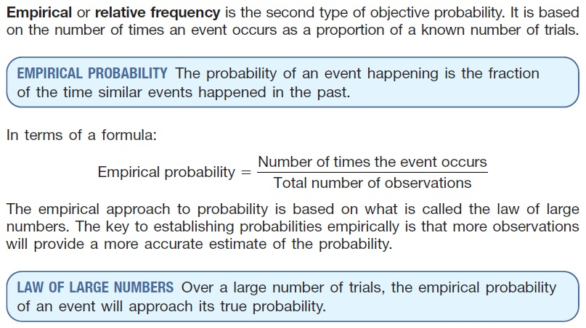
Empirical Probability

Slide 17
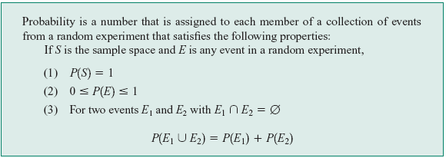
Axioms of Probability

Slide 18
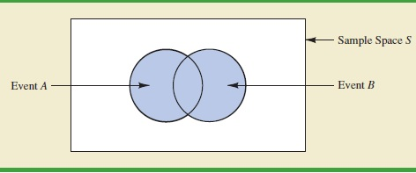

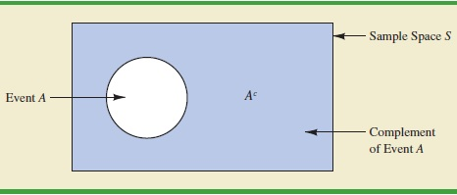

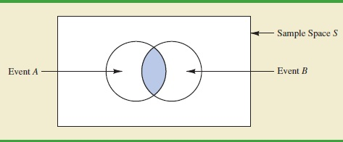
Axioms of Probability

Slide 19
Probability as a Numerical Measure of the Likelihood of Occurrence
Increasing Likelihood of Occurrence
0
.5
1
Probability:
The occurrence of the event is
just as likely as it is unlikely.

Slide 20
Example: 1
The sales manager of an e commerce company says that 80% of those who visit their website for the first time do not buy any mobile. If a new customer visits the website, what is the probability that the customer would buy mobile

Slide 21
Example 2
 | Blue | Black | Brown | Total
Software prog | 35 | 25 | 20 | 80
Project Mgrs | 7 | 8 | 5 | 20
Total | 42 | 33 | 25 | 100
If an employee is selected at random , what is the probability that he is a software prog? If an employee is selected at random , what is the probability that he is wearing a blue trouser

Slide 22
Example 3
A Survey conducted by a bank revealed that 40% of the accounts are savings accounts and 35% of the accounts are current accounts and the balance are loan accounts.
What is the probability that an account taken at random is a loan account ?
What is the probability that an account taken at random is NOT savings account ?
What is the probability that an account taken at random is NOT a current account
What is the probability that an account taken at random is a current account or a loan account?

Slide 23
Example 4
In a certain residential hub,60% of all households get internet service from the local cable company,80% get the television service from that company, and 50% get both services from that company.
If a household is randomly selected, what is the probability that it gets at least one of these two services from the company, and what is the probability that it gets exactly one of these services from the company?

Slide 24
EXAMPLE 5
A problem in statistics is given to 3 students P,Q and R whose chances of solving it are ½.3/4 and ¼ respectively.
What is the probability that the problem is solved?

Slide 25
EXAMPLE 6
A speaks truth in 80% cases and B speaks in 60% cases. What percentage of cases are they likely to contradict each other in stating the same fact.

Slide 26
EXAMPLE 7
If two dice are thrown , what is the probability that the sum is
Greater than 8
Less than 6
Neither 7 nor 11

Slide 27
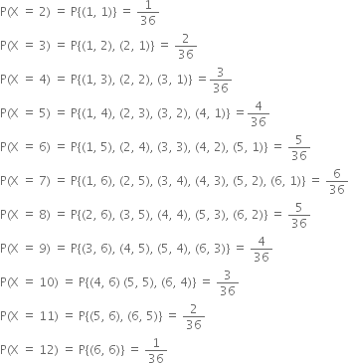
Example

Slide 28
If two dice are thrown , what is the probability that the sum is
Greater than 8
Less than 6
Neither 7 nor 11

Slide 29
If two dice are thrown , what is the probability that the sum is
Greater than 8
Less than 6
Neither 7 nor 11

Slide 30
EXAMPLE 8
The probability that ‘A’ will be alive 10 years hence is 5/8 and that B will be alive is ¾. Find the probability that
At least one is alive
Exactly one is alive
None are alive

Slide 31
Conditional Probability
Copyright © Cengage Learning. All rights reserved.

Slide 32
Conditional Probability
We will use the notation P(A | B) to represent the conditional probability of A given that the event B has occurred. B is the “conditioning event” As an example, consider the event A that a randomly selected student at your university obtained all desired classes during the previous term’s registration cycle. Presumably P(A) is not very large.
However, suppose the selected student is an athlete who gets special registration priority (the event B). Then P(A | B) should be substantially larger than P(A), although perhaps still not close to 1.

Slide 33
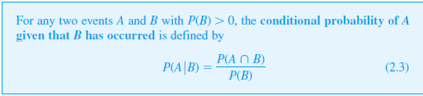
The Definition of Conditional Probability
Definition

Slide 34

The Multiplication Rule for P(A ∩ B)
The definition of conditional probability yields the following result, obtained by multiplying both sides of Equation (2.3) by P(B). The Multiplication Rule This rule is important because it is often the case that P(A ∩ B) is desired, whereas both P(B) and can be specified from the problem description.

Slide 35










Conditional Probability

Slide 36














Independent Events

Slide 37
Example
Suppose that A and B are events with probabilities: P(A)=1/3, P(B)=1/4, P(A ∩ B)=1/10
Find each of the following:
P(A | B)
P(B | A)
P(A’ | B’)

Slide 38
Solution
P(A) = 1/3, P(B) = 1/4, P(A ∩ B) = 1/10
P(A | B) = P(A ∩ B)/P(B)
=1/10/1/4 = 4/10
2. P(B | A) = P(A ∩ B)/P(A)
= 1/10/1/3 = 3/10
3. P(A’ | B’) = P(A’ ∩ B’)/P(B’) = P((A U B)’)/(1-P(B))
= (1-P(A U B))/(1 – P(B))
= (1 – (P(A)+P(B)-P(A ∩ B)))/(1-P(B))
= (1 – (1/3+1/4-1/10))/(1-1/10)
=(1-29/60)/9/10 = 31/60/9/10 = 31/54.

Slide 39
Example
Let E = the sum of the faces is even and S₂=the second die is a 2
Find
1. P(S₂ | E)
2. P(E | S₂)=

Slide 40
Solution
Let E=the sum of the faces is even and S₂=the second die is a 2
1. P(S₂ | E) =
P(S₂ ∩ E) /P(E)=
3/18=1/6
2. P(E | S₂)=
3/6=1/2

Slide 41
EXAMPLE : 9
From a city population , the probability of selecting a male or a smoker is 7/10, a male smoker is 2/5, and a male if a smoker is already selected is 2/3.
Find the probability of selecting
A non – smoker
A male
A smoker, if a male is first selected

Slide 42
Example : 10
Suppose that of all individuals buying a certain digital camera, 60% include an optional memory card in their purchase, 40% include an extra battery, and 30% include both a card and battery. Consider randomly selecting a buyer and let
A = {memory card purchased} and B = {battery purchased}.
Then P(A) = .60, P(B) = .40, P(both purchased) = P(A ∩ B) = .30

Slide 43

Solution
Given that the selected individual purchased an extra battery, the probability that an optional card was also purchased .
That is, of all those purchasing an extra battery, 75% purchased an optional memory card. Similarly, P(battery|memorycard)

Slide 44
Example 11
A news magazine publishes three columns entitled “ART”(A),”BOOKS”(B) and “CINEMA:(C). Reading habits of a randomly selected reader with respect to these columns are
a) Find the probability that he follows ART given that he read BOOKS regularly.
b) Find the probability that he follows ART given that he regularly follows at least
BOOKS or CINEMA.
c) Find the probability that he follows ART given that he regularly follows at least
one.
d) Find the probability that he follows atleast ART or BOOKS given that he follows
cinema regularly.
Read Regularly | A | B | C | A & B | A & C | B&C | A&B&C
Probability | 0.14 | 0.23 | 0.37 | 0.08 | 0.09 | 0.13 | 0.05

Slide 45



Example-11
a) Find the probability that he follows ART given that he read BOOKS regularly.

Slide 46
b) Find the probability that he follows ART given that he regularly follows at least BOOKS or CINEMA

Slide 47











c) Find the probability that he follows ART given that he regularly follows at least one.

Slide 48
d) Find the probability that he follows atleast ART or BOOKS given that he follows cinema regularly.

Slide 49
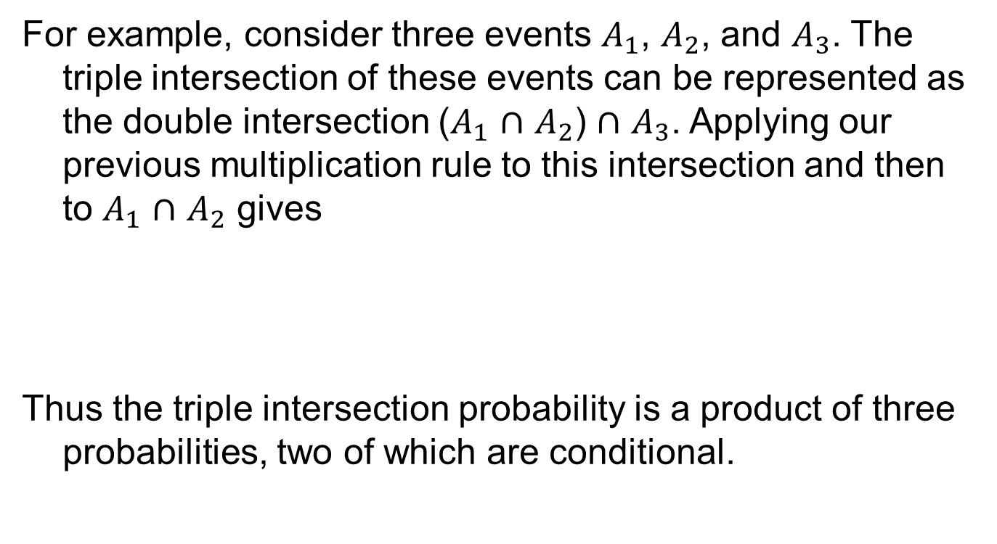

Slide 50
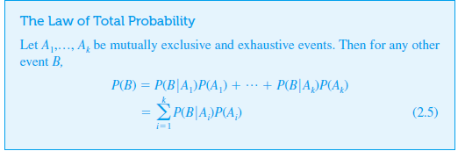

Slide 51
EXAMPLE
Three persons A,B and C are competing for the post of CEO of a company. The chances of they becoming CEO are 0.2,0.3 and 0.4 respectively.
The chances of they taking employees beneficial decisions are 0.50,0.45 and 0.6 respectively
What are the chances of having employees beneficial decisions after having new CEO

Slide 52
Example
An individual has 3 different email accounts. Most of her messages, in fact 70%, come into account #1, whereas 20% come into account #2 and the remaining 10% into account #3.
Of the messages into account #1, only 1% are spam, whereas the corresponding percentages for accounts #2 and #3 are 2% and 5%, respectively.
What is the probability that a randomly selected message is spam?

Slide 53
EXAMPLE
Three persons A,B and C are competing for the post of CEO of a company. The chances of they becoming CEO are 0.2,0.3 and 0.4 respectively.
The chances of they taking employees beneficial decisions are 0.50,0.45 and 0.6 respectively
What are the probabilities of chances of having employees' beneficial decisions after having A as new CEO
Similarly, B
Similarly, C

Slide 54
Example
An individual has 3 different email accounts. Most of her messages, in fact 70%, come into account #1, whereas 20% come into account #2 and the remaining 10% into account #3.
Of the messages into account #1, only 1% are spam, whereas the corresponding percentages for accounts #2 and #3 are 2% and 5%, respectively.
What is the probability that a randomly selected spam message belongs to account # 1

Slide 55
Example
In a city patients visits three doctors A,B and C in the ratio 6:5:7.The chance that these doctors refers a case to a specialist are 54%,60% and 55% respectively.
If a patient visits a specialist , what is the probability that he is referred by doctor A

Slide 56
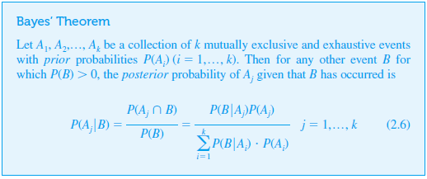
Bayes’ Theorem

Slide 57






WEATHER | PLAY | WEATHER | PLAY
SUNNY | YES | SUNNY | YES
OVERCAST | NO | OVERCAST | NO
RAINY | NO | RAINY | NO
SUNNY | YES | SUNNY | YES
SUNNY | NO | RAINY | NO
RAINY | YES | OVERCAST | YES

Slide 58




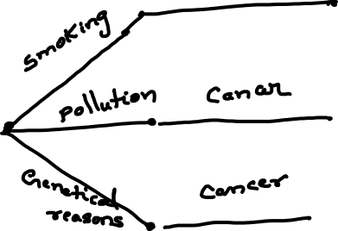



Slide 59
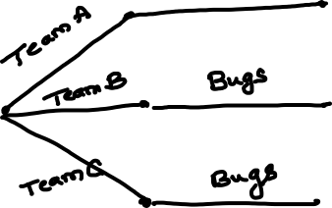










Slide 60

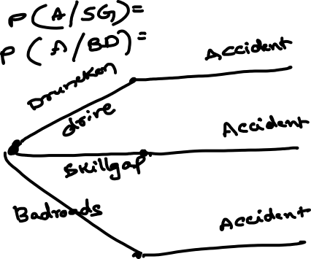







Slide 61
Thanks

